Slide 1

IOT BASED SMART GARAGE DOOR OPENER
Group-4

Slide 2
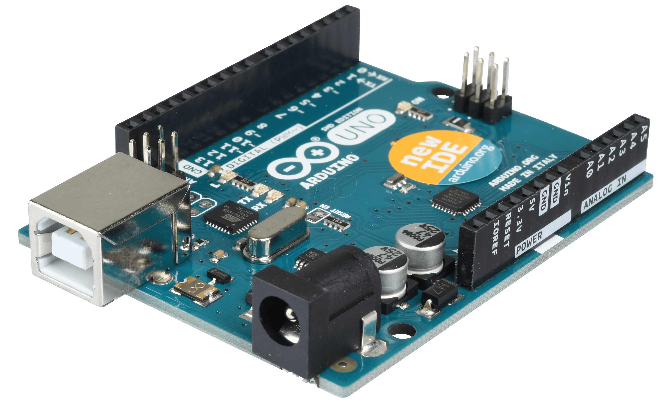
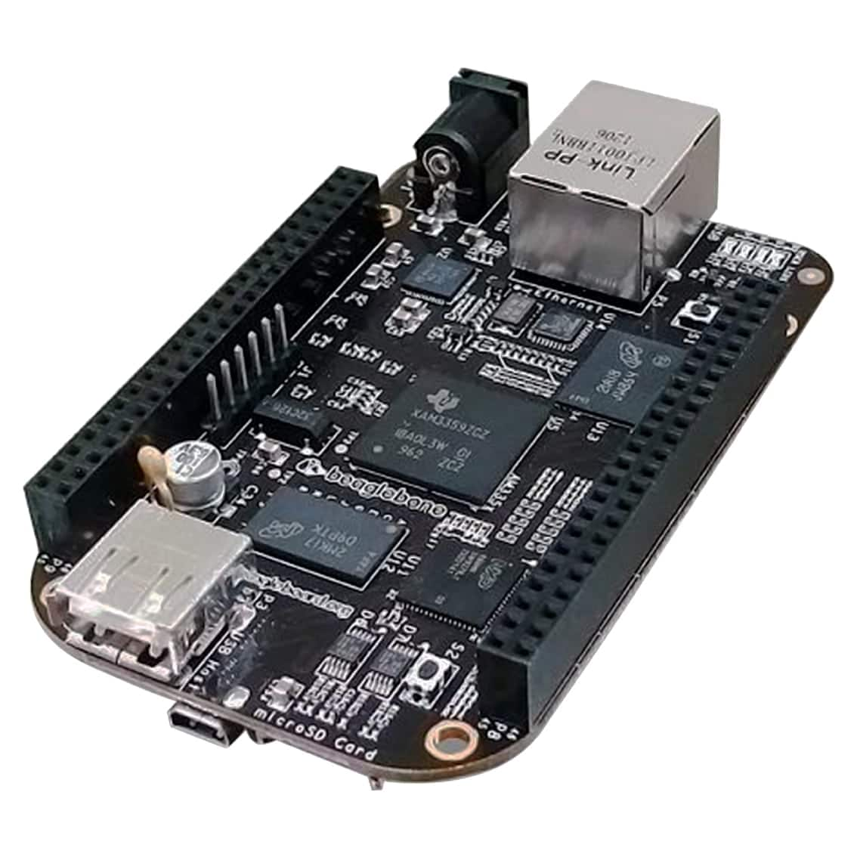
INTERFACING BEAGLEBONE BLACK WITH ARDUINO UNO
Presented by- Gopikrishnan KG

Slide 3
Contents
Block Diagram of the project
Communication Protocol used for the interfacing
Hardware Components used
Software part of the interfacing
Output
Demonstration
References

Slide 4
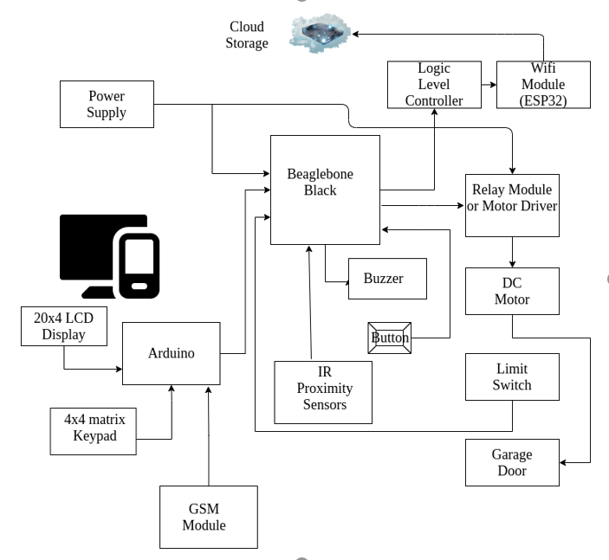
BLOCK DIAGRAM OF THE PROJECT

Slide 5
Why to interface beaglebone black with Arduino uno?
Beaglebone Black is the Main Microcontroller in the project
Beaglebone black connected to all components directly or indirectly
Arduino Uno is the slave micro controller in the project
Arduino Uno enhances the security feature
Interfacing of Beaglebone Black and Arduino Uno is key to the project’s successful implementation

Slide 6
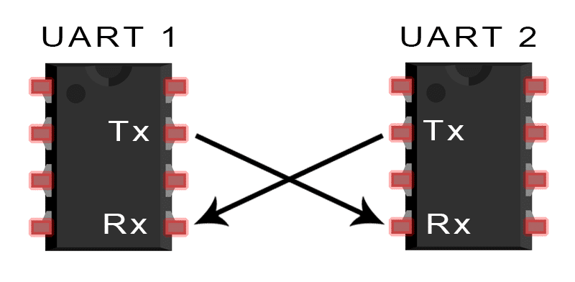
COMMUNICATION PROTOCOL USED- UART

Slide 7
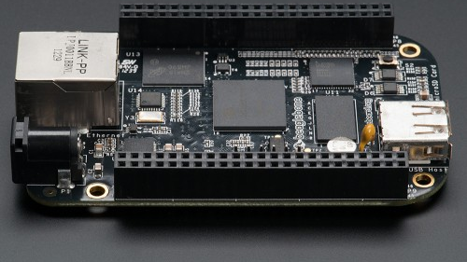
Uart communication in beaglebone black
To get UART communication working on the Beaglebone Black, the normal UART pins set as normal GPIO pins needs to be changed as UART pins before they will work. For enabling this, running a small script is essential when the BBB starts and before the application runs. These set of instructions will enable UART4(ttys4) of the Beaglebone Black.

Slide 8
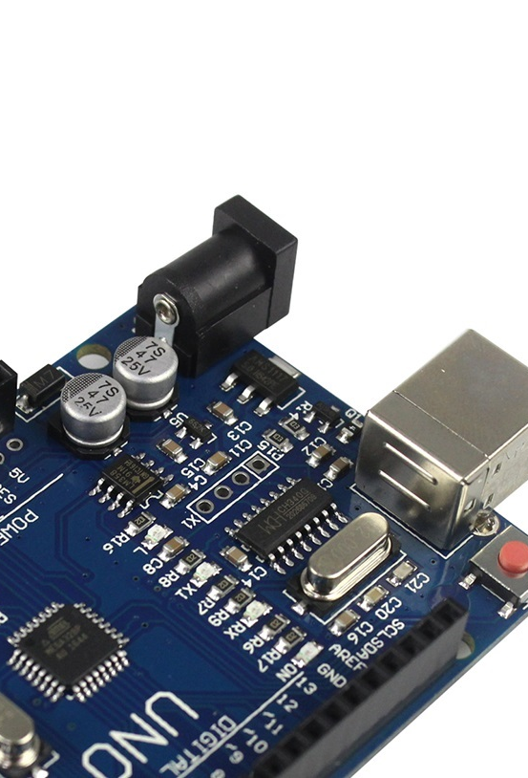
Uart communication protocol in arduino
Via GPIO pins-In case of Arduino, UART communication can be enabled through GPIO pins. In this case Txd is used for transmitting serial data and Rxd to receive serial data. Both the devices communicating should have the same baud rate and data encoding. If the devices connected are to different baud rates, the devices won’t be able to communicate properly or exchange data. The data exchanged in such a case can get corrupted or gibberish.
Through Arduino USB- Arduino can also communicate over a USB. However, in this interfacing it does not exchange data over UART protocol. Rather in this case one device should be configured as a master and the other as a slave. Data is sent as packets in this case.

Slide 9
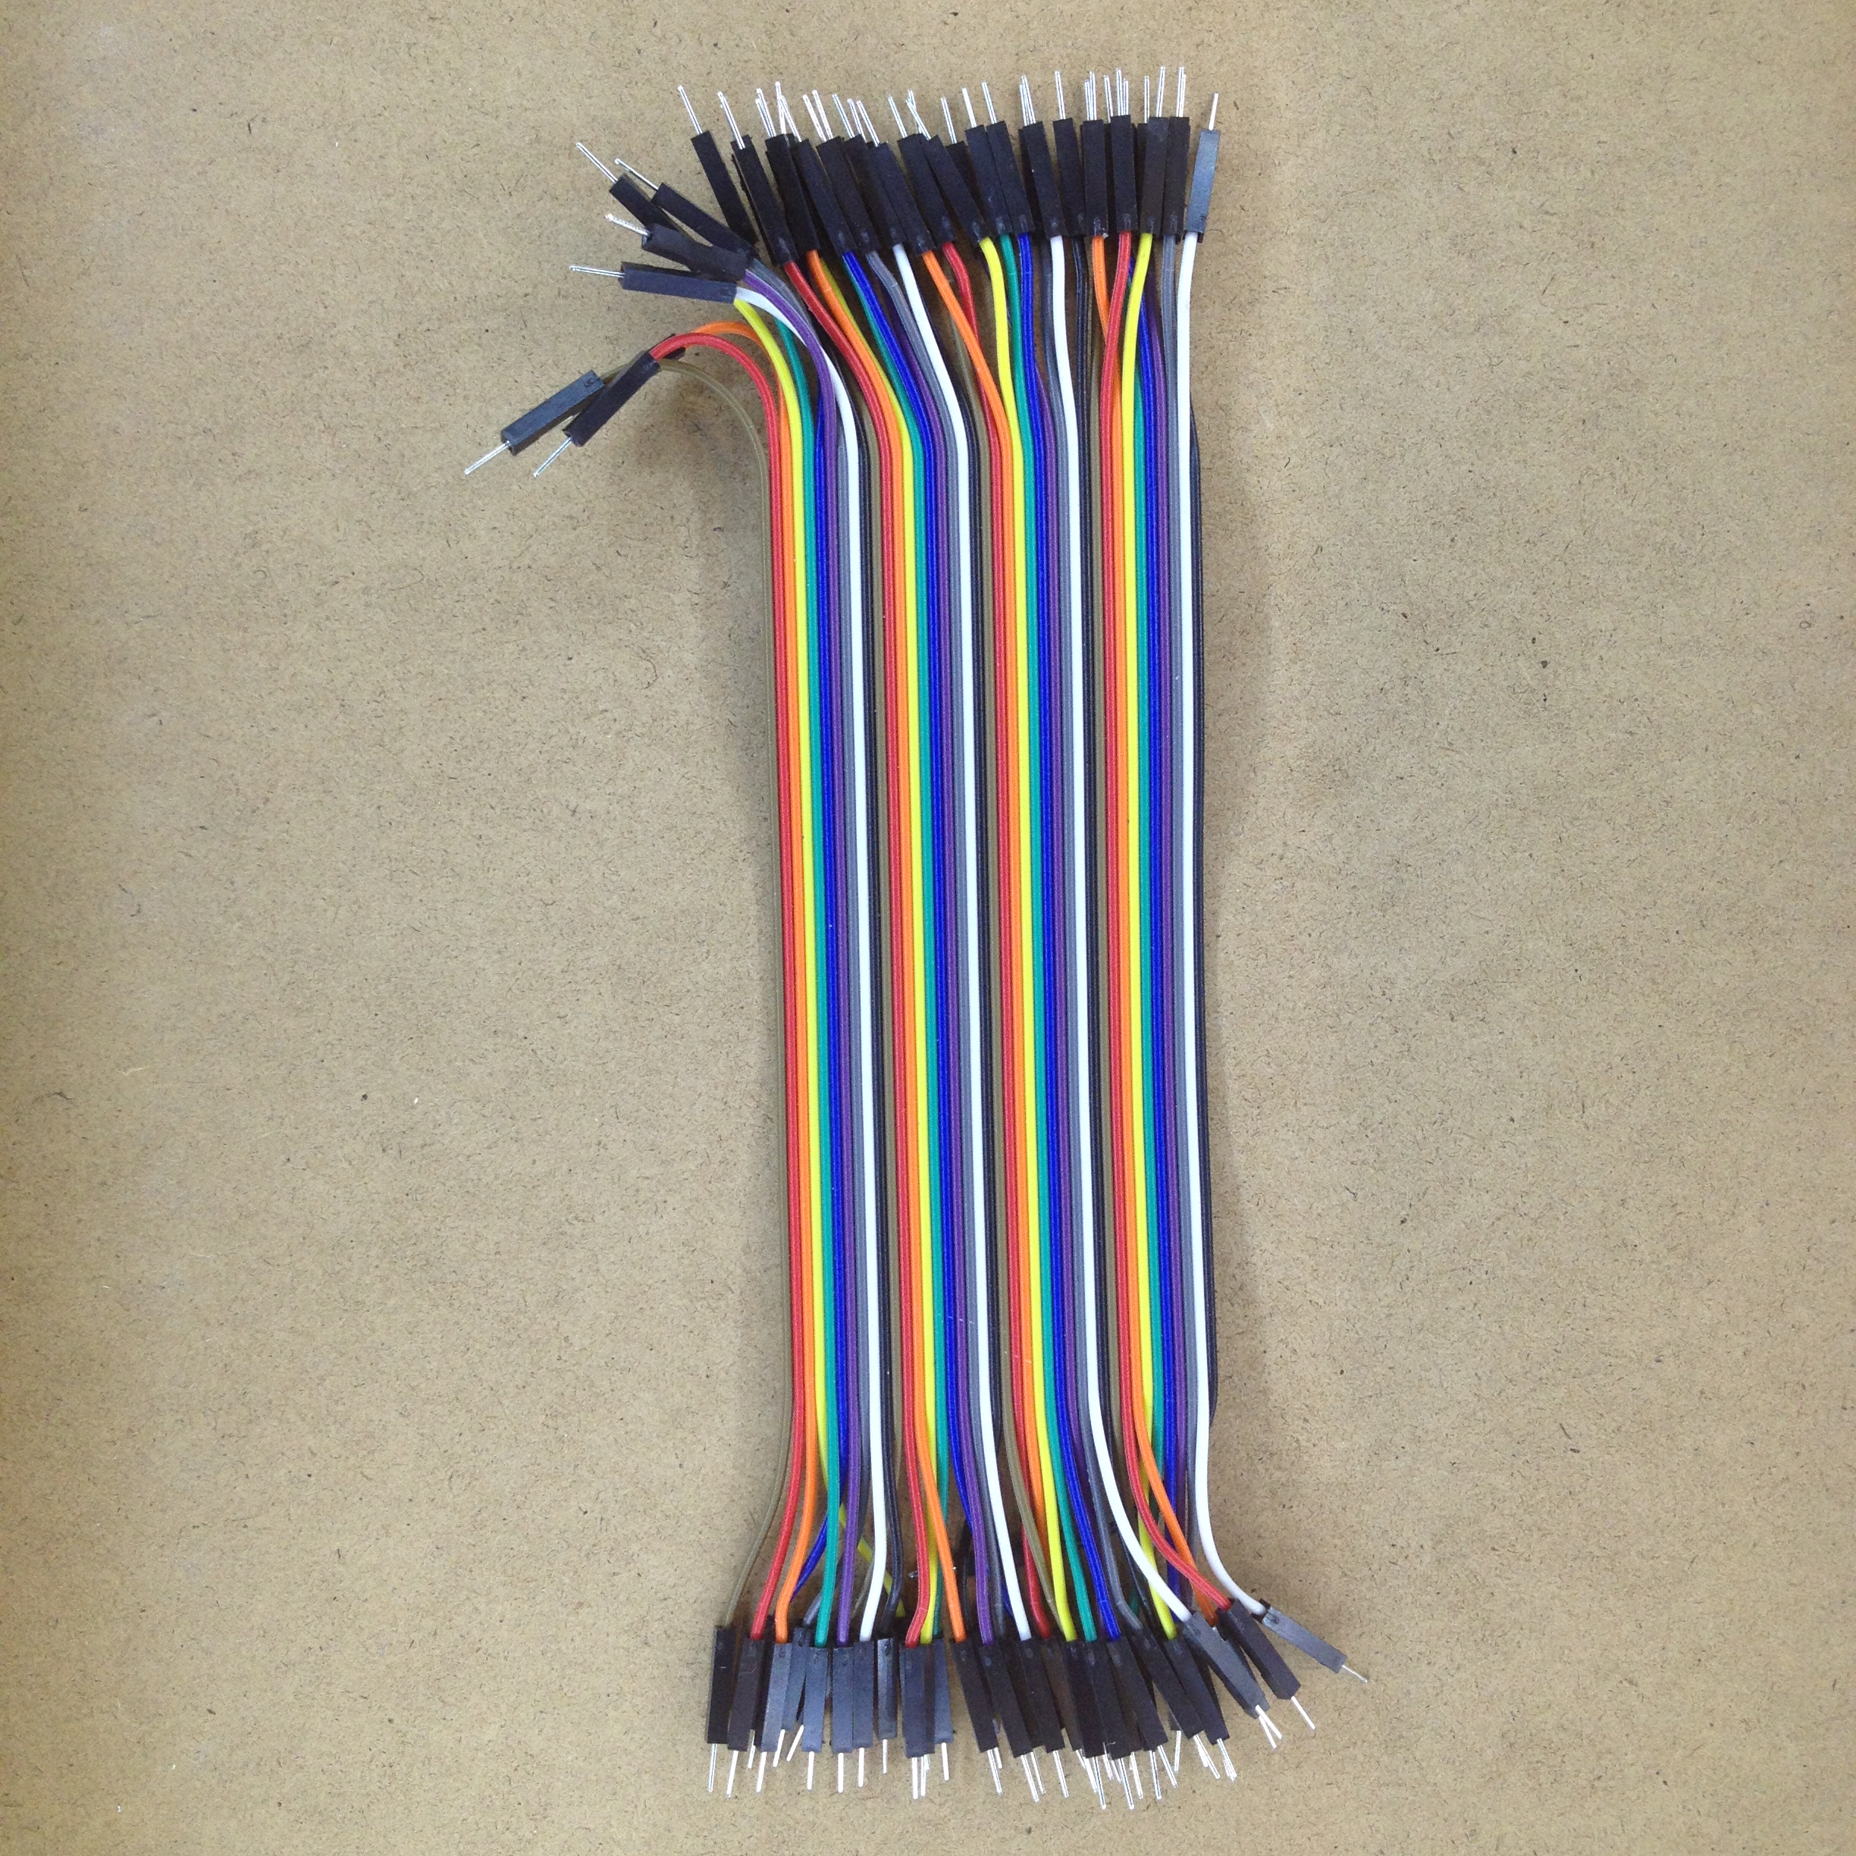

Hardware components used
Beaglebone Black and USB Cable
Arduino Uno and USB cable
M-M connectors
Host Machine

Slide 10
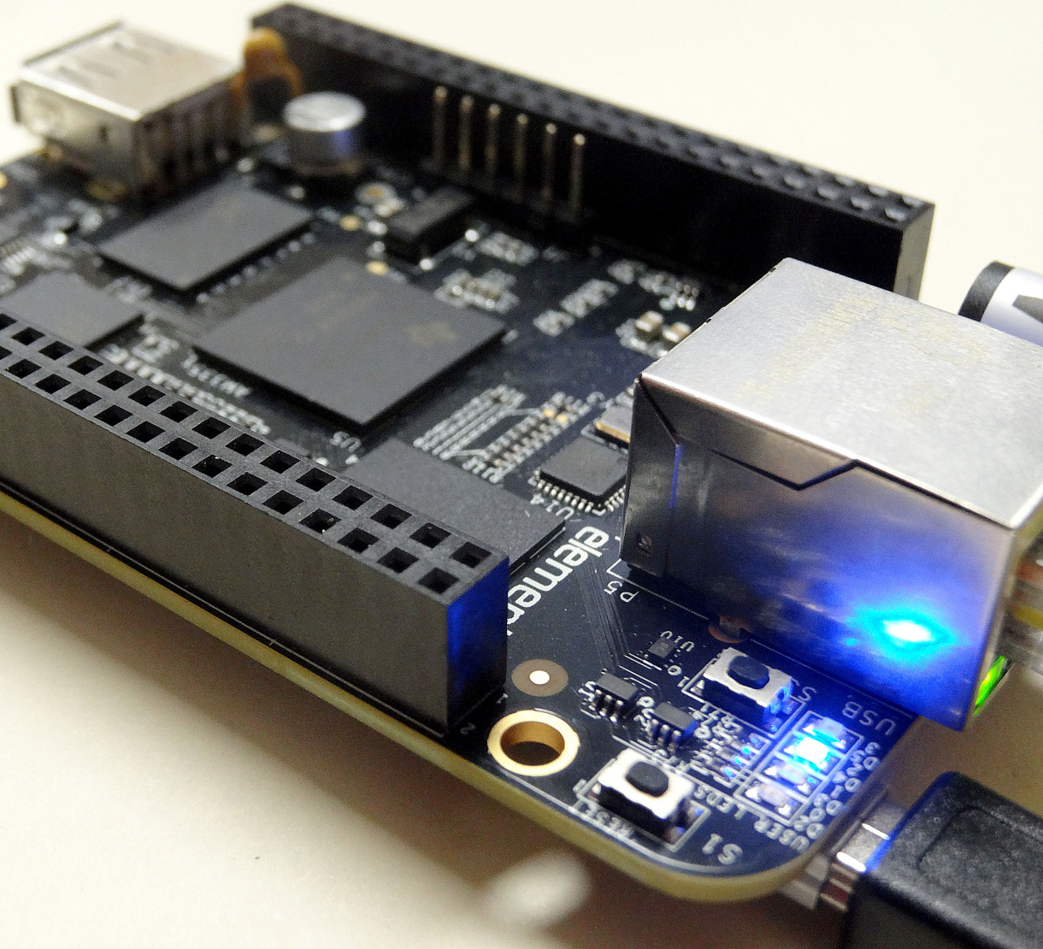
Beaglebone black

Slide 11
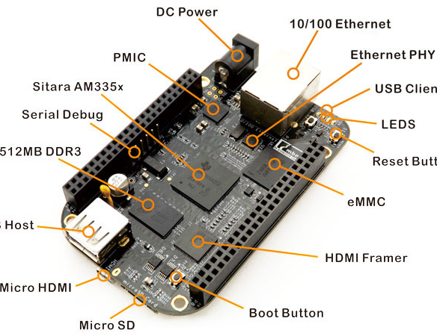
Main Features
Processor: Sitara AM335x 1GHz ARM® Cortex-A8
512MB DDR3 RAM
4GB 8-bit eMMC on-board flash storage
3D graphics accelerator
NEON floating point accelerator
2x PRU 32-bit microcontrollers

Slide 12
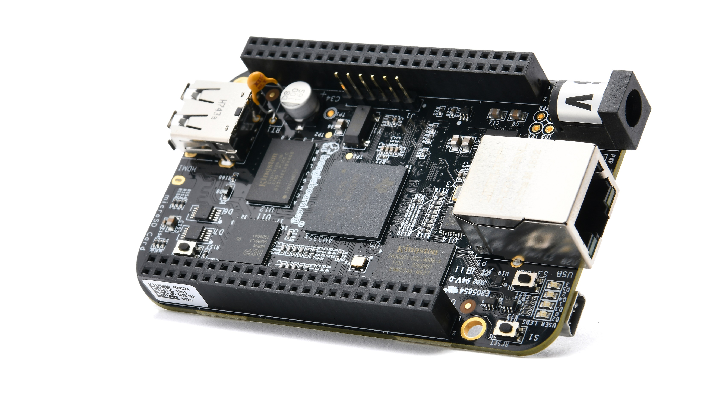
Connectivity
USB CLIENT FOR POWER AND COMMUNICATIONS
USB HOST
ETHERNET
HDMI
2*46 PIN HEADERS

Slide 13
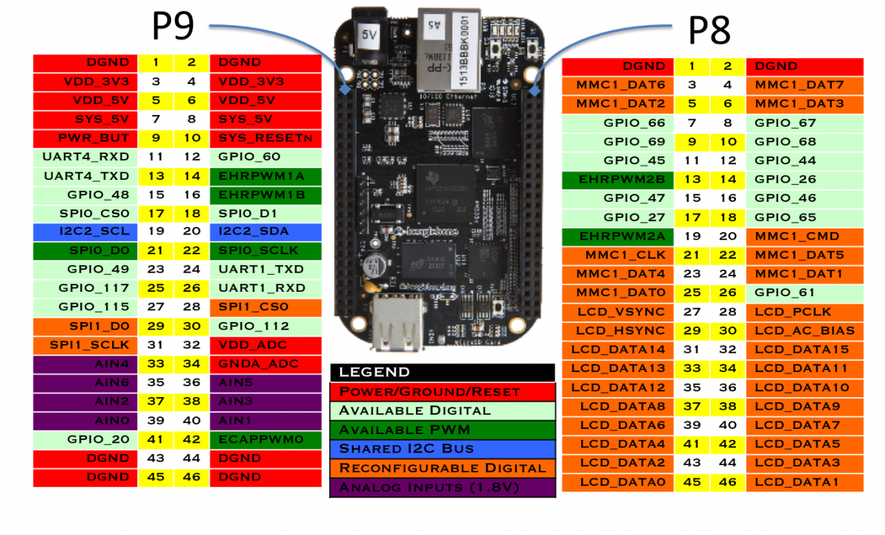
Pin Diagram
Contains two Pin headers P8 and P9
Each header contains 46 pins each
Left side header is P9 and, right side header is P8
Pin out consist of various power source , GPIO, SPI/I2C , ADC , PWM ,UART pin, LCD data and control pin etc

Slide 14
PINS USED FOR THIS INTERFACING
DGND- Connected to Gnd of Arduino
UART4_RXD – Connected to Pin 2 of Arduino
UART4_TXD – Connected to Pin3 of Arduino

Slide 15
Arduino UNO

Slide 16
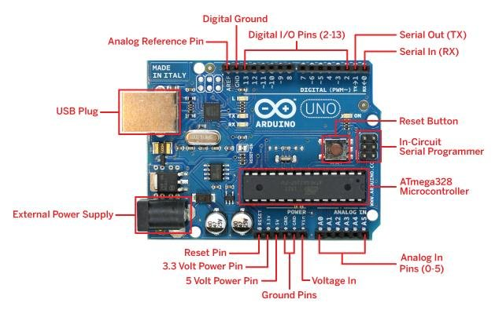
MAIN FEATURES
14 digital I/O pins (six of which provide PWM output)
3.3 V supply generated by an on-board regulator
Six analog input pins
32 KB of flash memory
Can supply 40 mA of DC current per pin
16 MHz clock speed
SRAM: 2KB
EEPROM: 1KB

Slide 17
What Communication Interfaces are available on Arduino UNO?
SERIAL : Most common interface used, Arduino boards(UNO, Nano and Mega) are programmed with serial communication. Digital I/O pins 0 and 1 are used as serial RX and TX pins to receive and transmit data.
I2C OR I^2C : Analog input pins A4 and A5 have alternative functions. Both of it can be configured as SDA(Serial Data Line)(A4) and SCL(Serial Clock Line)(A5) to support I2C or I^2C or Two Wire Interface(TWI)
SPI (Serial Peripheral Interface): Digital IO pins 10,11,12 and 13 can be configured as SPI pins SS(Slave select),MOSI(Master Output/Slave Input),MISO(Master Input/Slave Output) and SCK(Serial Clock) respectively.

Slide 18
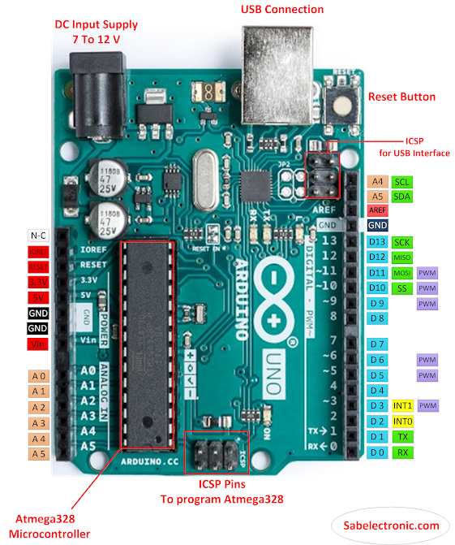
PIN DIAGRAM
Pin A4 and A5- used for I2C or I^2C communication.
D10, D11, D12, D13- used for SPI communication.
D0 and D1- used for serial communication.

Slide 19
Pins Used for this interfacing
Gnd- Connected to DGND pin of Beaglebone Black
Pin 2- Connected to UART4_RXD pin of Beaglebone Black
Pin 3- Connected to UART4_TXD pin of Beaglebone Black

Slide 20
M-M Jumper wires
Jumper wires come in three types , Male to Male, Male to Female, and Female to Female.
Difference between each comes in the end point of the wire.
Male ends have a pin protruding and can plug into things, while on the female end, we can plug things into.
When we connect between ports M-M jumper wires are generally used.

Slide 21
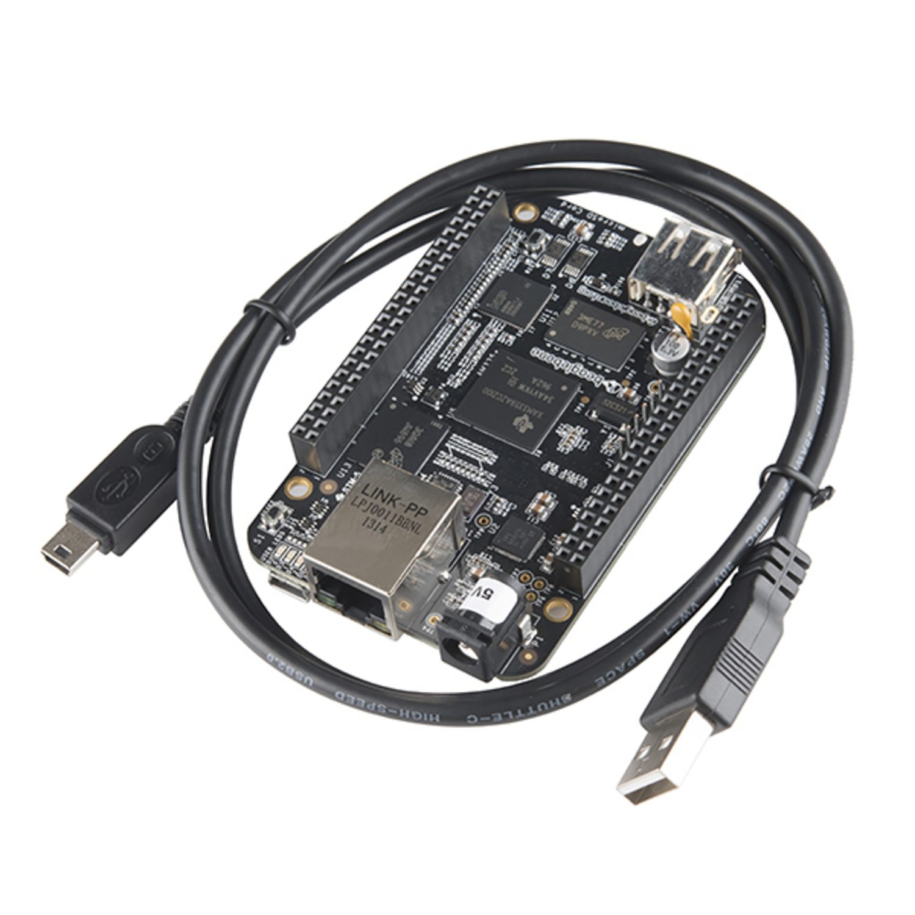
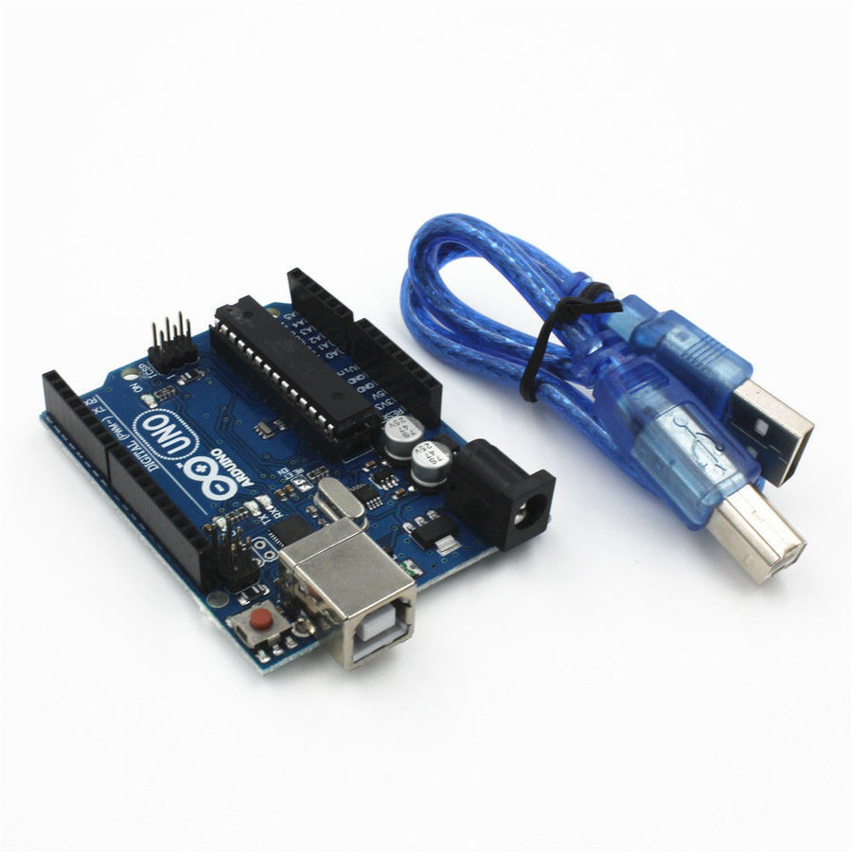
HOST MACHINE AND USB CABLES
Laptop- For compiling and running the code.
USB Cable- To connect the Beaglebone Black and Arduino Uno boards with Host machine.

Slide 22
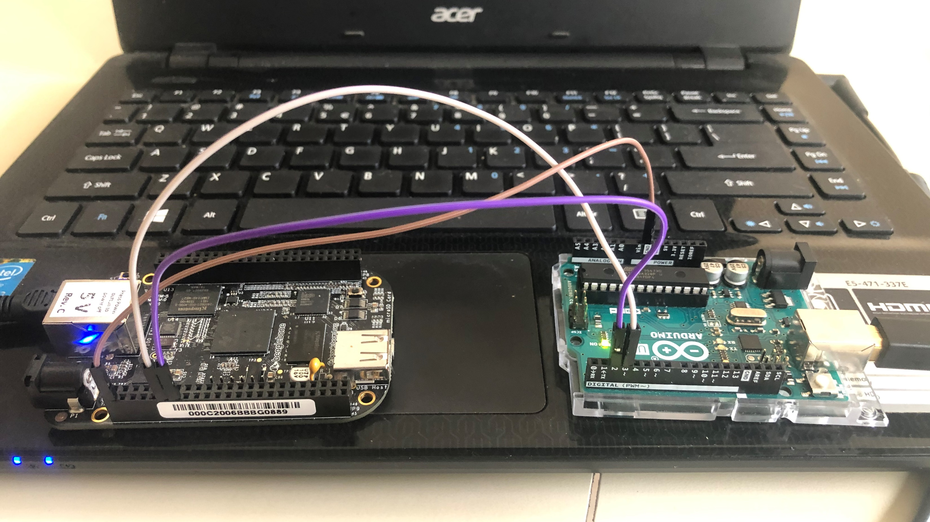
CIRCUIT

Slide 23

SOFTWARE PART OF THE INTERFACING

Slide 24

GNU NANO
Small user-friendly console text editor
It is a text editor Unix-like computing systems or operating environments using a command line interface
Used for writing, Compiling and executing C code essential for interfacing

Slide 25

Arduino ide
Arduino IDE is a cross platform application for windows, MacOS and Linux that is written in functions of C and C++. It is used for writing and uploading programs to Arduino compatible boards. This IDE is released under the GNU general public license version 2.
In this interfacing Console of the IDE is used to display the messages sent by the Beaglebone Black. The IDE also enables the sending of messages to Beaglebone Black which can be viewed in the Linux terminal.

Slide 26

Libraries used
stdio.h – Standard input output C Library
unistd.h- To use functions like file opening, closing, sleep etc
Terminos.h- for setting up UART communication
Fcntl.h – file control functions like O_RDWR, O_NONBLOCK etc
String.h- for string operations

Slide 27
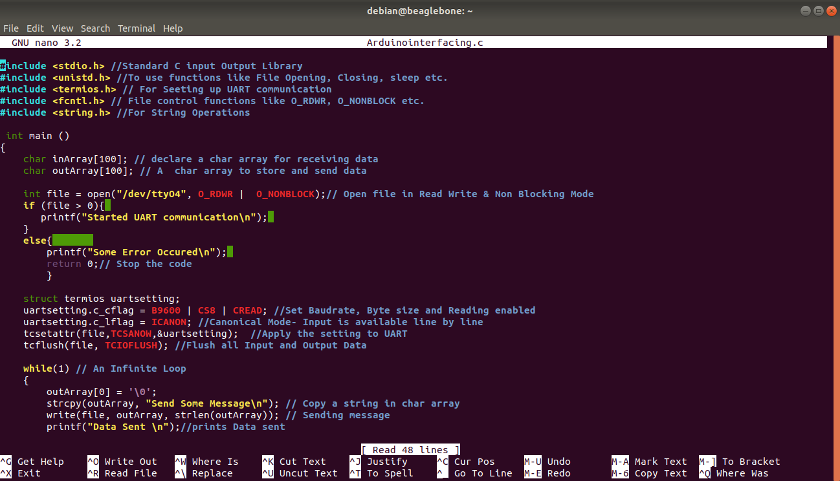

Slide 28
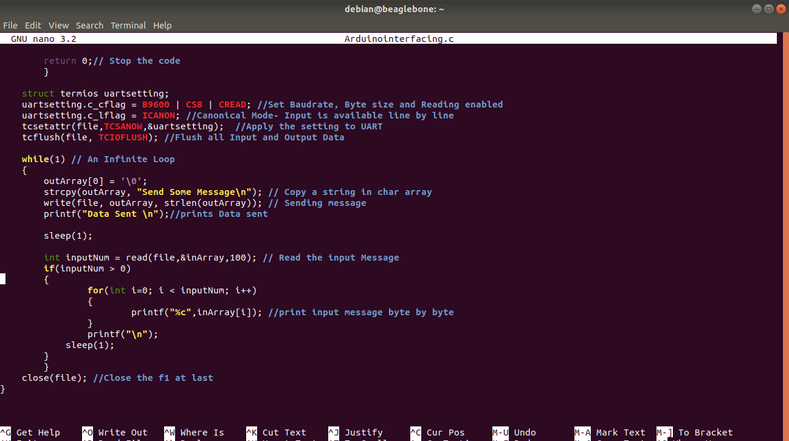

Slide 29
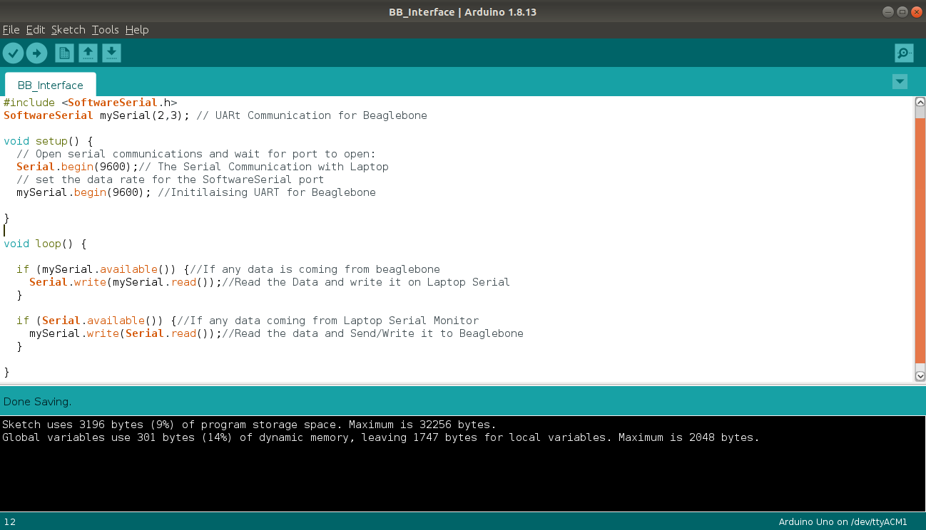
Arduino code

Slide 30
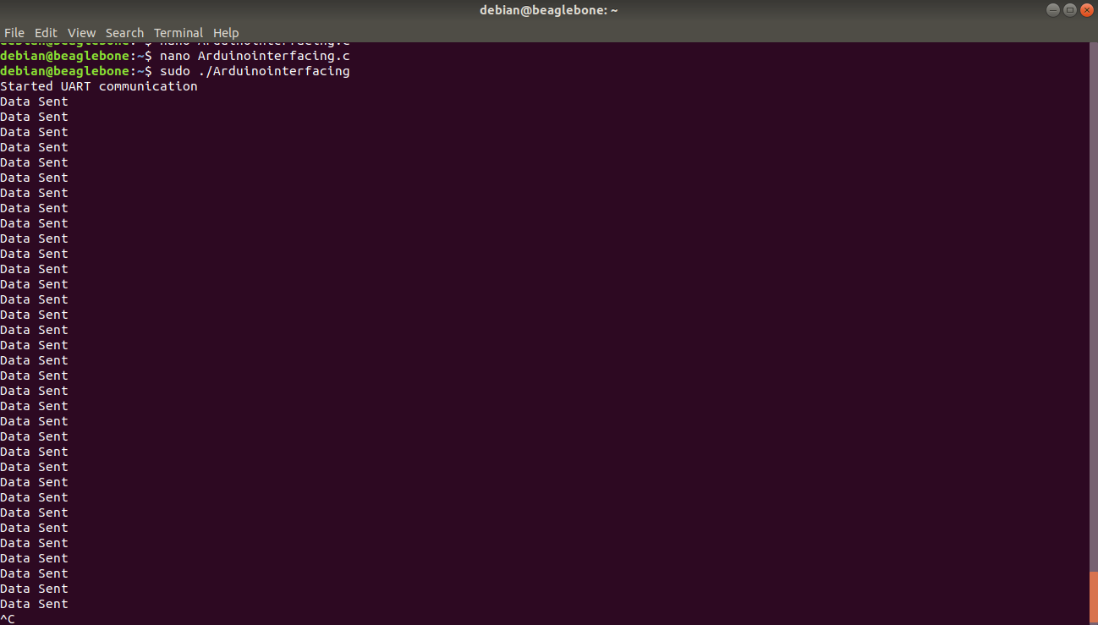
output

Slide 31
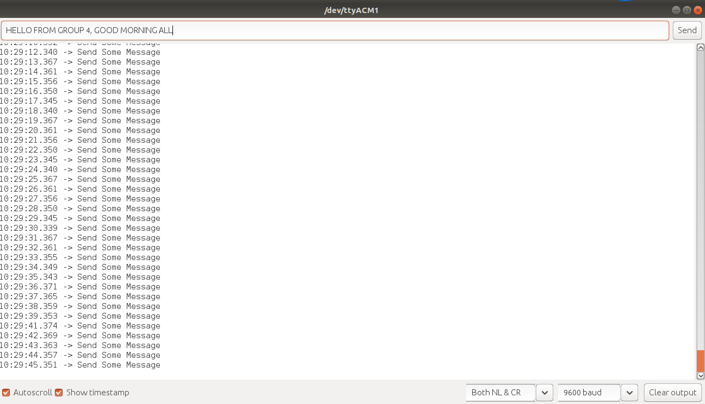
output

Slide 32
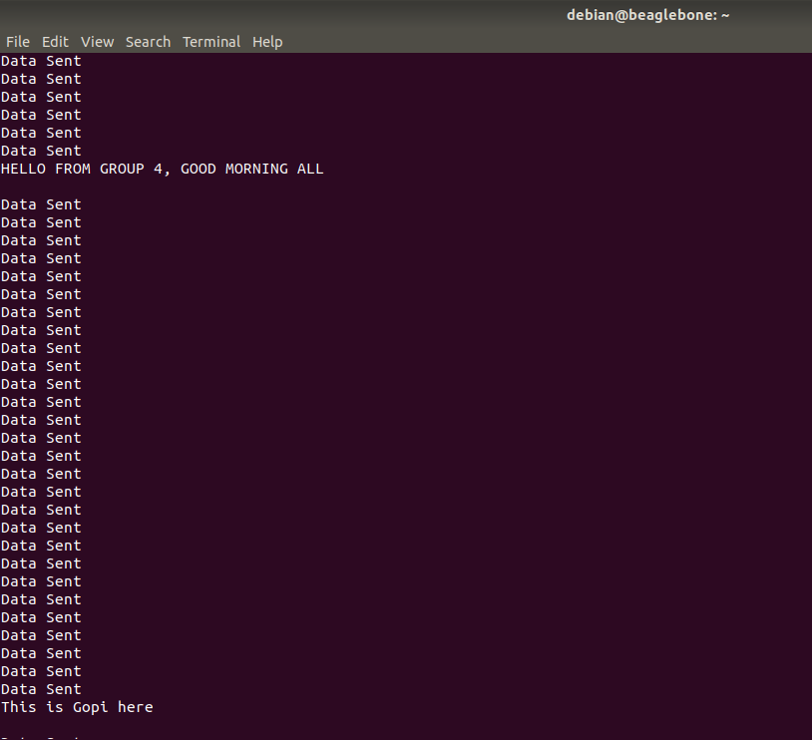
output

Slide 33
References
Retrieved from engineersgarage.com, Getting started with Beaglebone black(2020, October 1) URL:https://www.engineersgarage.com/electronic-projects/getting-started-with-beaglebone-black-part-1-15/
Retrieved from Beaglebone.org. URL:http://beagleboard.org/black
Retrieved from microcontrollerslab.com, BeagleBone Black Pinout, Pin configuration and features. URL:https://microcontrollerslab.com/beaglebone-black-pinout-pin-configuration-features-applications
Retrieved from Components101.com, Arduino UNO( 2018, February 18) URL:https://components101.com/microcontrollers/arduino-uno
Retrieved from etechnophiles.com, Arduino UNO Pinout, Pin diagram, specifications and features in Detail. URL: https://www.etechnophiles.com/arduino-uno-pinout-pin-diagram-specifications/

Slide 34
REFERENCES
Retrieved from electronicshub.org, Arduino UNO Pinout, Specifications , Board Lay Out, Pin Description (2021, January 15). URL:https://www.electronicshub.org/arduino-uno-pinout/
Retrieved from engineersgarage.com, Sending Data from Beaglebone Black to Arduino Through UART(Part 7/15)(2016,August 5) URL: https://www.engineersgarage.com/electronic-projects/sending-data-from-beaglebone-black-to-arduino-through-uart-part-7-15/
Retrieved from electronics.trev.id.au, How to get UART serial ports working on the beaglebone black(2018, February 9). URL:https://electronics.trev.id.au/2018/02/09/get-uart-serial-ports-working-beaglebone-black/
Retrieved from gaiger-programming.blogspot.com, Simple Linux Serial programming in C URL:http://gaiger-programming.blogspot.com/2015/03/simple-linux-serial-port-programming-in.html
Retrieved from elinux.org URL: https://elinux.org/images/b/b7/Uart-loopback.c

Slide 35
REFERENCES
Retrieved from engineersgarage.com, Arduino compatible coding 16: Serial UART communication(2020,August 11) URL:https://www.engineersgarage.com/microcontroller-projects/articles-arduino-serial-communication-uart/#:~:text=The%20UART%20through%20Arduino%20USB%20Arduino%20can%20also,host%20and%20the%20other%20device%20as%20a%20slave.
Retrieved from teachmemicro.com, Beaglebone black serial connection to Arduino URL:https://www.teachmemicro.com/beaglebone-black-serial-arduino/
Retrieved from indestructibles.com, How to make a Beaglebone Black and an Arduino communicate URL:https://www.instructables.com/How-to-make-a-BeagleBone-and-an-Arduino-communicat/

Slide 36

Thank You

